Slide 1
Experiment No. 2
Problem Definition: 2. a) Develop and demonstrate, using Javascript , an XHTML document that collects the USN ( the valid format is: A digit from 1 to 4 followed by two upper-case characters followed by two digits followed by two upper-case characters followed by three digits; no embedded spaces allowed) of the user. Event handler must be included for the form element that collects this information to validate the input. Messages in the alert windows must be produced when errors are detected.
b) Modify the above program to get the current semester also (restricted to be a number from 1 to 8)
CSE@GIT
Department of Computer Science and Engineering, GIT

Slide 2
Objectives of the Experiment:
To demonstrate the use of JavaScript and XHTML
To develop an understanding of JavaScript syntax
CSE@GIT
Department of Computer Science and Engineering, GIT

Slide 3
Need of the Experiment
JavaScript allows you to build interactive websites.
JavaScript has become an essential web technology along with HTML and CSS, as most browsers implement JavaScript.
For web development, as a front-end developer or on using JavaScript for backend development.
JavaScript usage has now extended to mobile app development, desktop app development, and game development.
Department of Computer Science and Engineering, GIT

Slide 4
Theoretical Background of the Experiment
JavaScript is an interpreted, scripting language, designed to add interactivity to HTML pages
It is used in Web pages to improve the design, validate forms, detect browsers, create cookies
Most popular scripting language on the internet, and works on all major browsers like Firefox, Chrome, Opera, IE
It is usually embedded directly into HTML pages
Can be used without purchasing a license
JavaScript
Department of Computer Science and Engineering, GIT

Slide 5
Theoretical Background of the Experiment
JavaScript
JavaScript created by Netscape
Joint Development with Sun Microsystems in 1995
JScript created by Microsoft
IE and Netscape renderings are slightly different
Standardized by European Computer Manufacturers Association (ECMA) - http://www.ecma-international. org/publications /standards/Ecma-262.htm
Department of Computer Science and Engineering, GIT

Slide 6
Theoretical Background of the Experiment
Uses of JavaScript
Provide alternative to server-side programming , Servers - often overloaded , Client processing - quicker reaction time
JavaScript can work with forms
Event-Driven Computation - a JavaScript program could validate data in a form before it is submitted to a server
JavaScript can interact with the internal model of the web page (Document Object Model)
JavaScript is used to provide more complex user interface than plain forms with HTML/CSS can provide
Department of Computer Science and Engineering, GIT

Slide 7
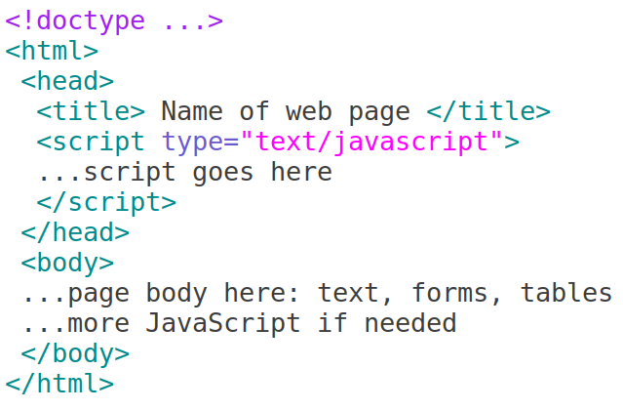
JavaScript – General Format -
Directly embedded
Department of Computer Science and Engineering, GIT

Slide 8
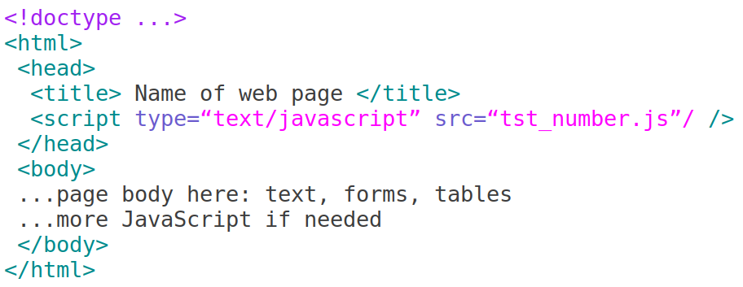
JavaScript – General Format
Indirect reference
Department of Computer Science and Engineering, GIT

Slide 9
Ending Statements With a Semicolon?
JavaScript Basic Examples
With traditional programming languages, like C++ and Java, each code statement has to end with a semicolon (;).
Many programmers continue this habit when writing JavaScript, but in general, semicolons are optional! However, semicolons are required if you want to put more than one statement on a single line.
<script>
document.write("Hello World!")
</script> ⇒ format text with HTML code - heading
Department of Computer Science and Engineering, GIT

Slide 10
How to Put a JavaScript Into an HTML Page?
Example
<html>
<body>
<script type="text/javascript">
document.write("Hello World!")
</script>
</body>
</html>
<script>
x="Hello World!"
document.write(x)
</script>
<script>
x="World"
document.write("Hello " +x)
</script>
Department of Computer Science and Engineering, GIT

Slide 11
How to Put a JavaScript Into an HTML Page?
JavaScript Popup Boxes - alert
<html>
<body>
<script type="text/javascript">
document.write("Hello World!")
</script>
</body>
</html>
Alert Box
An alert box is used if you want to make sure information comes through to the user.
When an alert box pops up, the user will have to click "OK" to proceed.
<script>
alert("Hello World!")
</script>
Department of Computer Science and Engineering, GIT

Slide 12
How to Put a JavaScript Into an HTML Page?
JavaScript Popup Boxes - confirm
<html>
<body>
<script type="text/javascript">
document.write("Hello World!")
</script>
</body>
</html>
Confirm Box
A confirm box is used if you want the user to verify or accept something.
When a confirm box pops up, the user will have to click either "OK" or "Cancel" to proceed.
If the user clicks "OK", the box returns true. If the user clicks "Cancel", the box returns false.
Department of Computer Science and Engineering, GIT

Slide 13
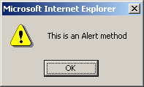
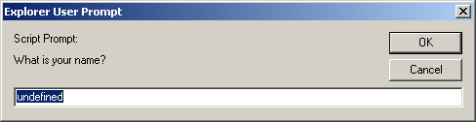
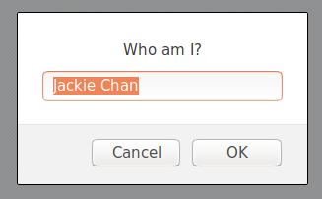
alert(), confirm(), and prompt()
<script type="text/javascript">
alert("This is an Alert method");
confirm("Do you want to continue this download?");
prompt("What is your name?");
prompt("Who am I?","Jackie Chan");
</script>

Slide 14
promt()
How to Put a JavaScript Into an HTML Page?
Return valut of promt() is the value enter in text area
On cliciking OK or pressing Enter , the value can be collected in a vairable
returnValue = promt("Enter a number");
<html>
<body>
<script type="text/javascript">
document.write("Hello World!")
</script>
</body>
</html>
Department of Computer Science and Engineering, GIT

Slide 15
How to Put a JavaScript Into an HTML Page?
JS Examples -1
<html>
<body>
<script type="text/javascript">
document.write("Hello World!")
</script>
</body>
</html>
y =20 x + 12 ,
if x=3 then, what will be the value of y ?
<script>
x=3
y=20*x+12
alert(y)
</script>
Department of Computer Science and Engineering, GIT

Slide 16
How to Put a JavaScript Into an HTML Page?
Examples -2
<html>
<body>
<script type="text/javascript">
document.write("Hello World!")
</script>
</body>
</html>
<script>
s1=12
s2=28
total=s1+s2
document.write("sum of two nos.: "+total)
</script>
Department of Computer Science and Engineering, GIT

Slide 17

Statements and Primitive Types
How to Put a JavaScript Into an HTML Page?
Statements can be terminated with a semicolon
But, the interpreter will insert the semicolon if missing at the end of a line
Can be a problem:
If a statement must be continued to a new line, make sure that the first line does not make a complete statement by itself
Five primitive types – Number , String , Boolean , Undefined , Null
Date object
<html>
<body>
<script type="text/javascript">
document.write("Hello World!")
</script>
</body>
</html>
Department of Computer Science and Engineering, GIT

Slide 18
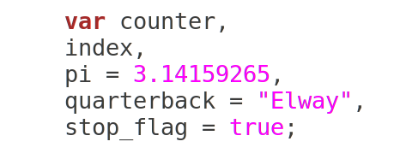
Declaring variable
How to Put a JavaScript Into an HTML Page?
Dynamically typed
<html>
<body>
<script type="text/javascript">
document.write("Hello World!")
</script>
</body>
</html>
Department of Computer Science and Engineering, GIT

Slide 19
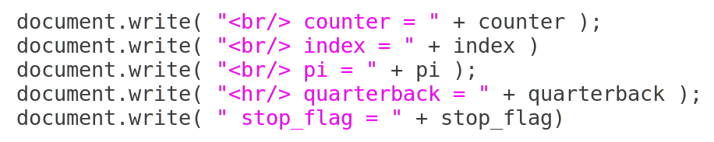
String Catenation +
How to Put a JavaScript Into an HTML Page?
+
Types automatically converted to string
Implicit , Explicit type conversion
<html>
<body>
<script type="text/javascript">
document.write("Hello World!")
</script>
</body>
</html>
Department of Computer Science and Engineering, GIT

Slide 20
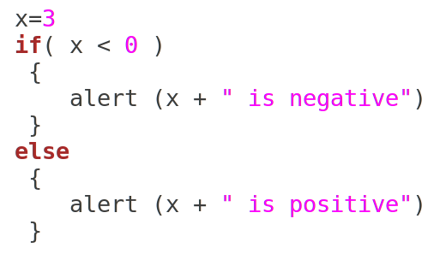
Conditional Statements
How to Put a JavaScript Into an HTML Page?
Similar to C/C++/Java
if statement
if...else statement
if...else if....else statement
switch statement
<html>
<body>
<script type="text/javascript">
document.write("Hello World!")
</script>
</body>
</html>
Department of Computer Science and Engineering, GIT

Slide 21
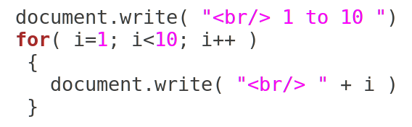
Looping Statements
How to Put a JavaScript Into an HTML Page?
Loop statements in JavaScript are similar to those in C/C++/Java
while
for
do while
<html>
<body>
<script type="text/javascript">
document.write("Hello World!")
</script>
</body>
</html>
Department of Computer Science and Engineering, GIT

Slide 22
Looping Statements – Print prime numbers
How to Put a JavaScript Into an HTML Page?
Prime Number - A number that is divisible only by itself and 1
Using looping statement find and print prime numbers from 2 to 100
<html>
<body>
<script type="text/javascript">
document.write("Hello World!")
</script>
</body>
</html>
Department of Computer Science and Engineering, GIT

Slide 23
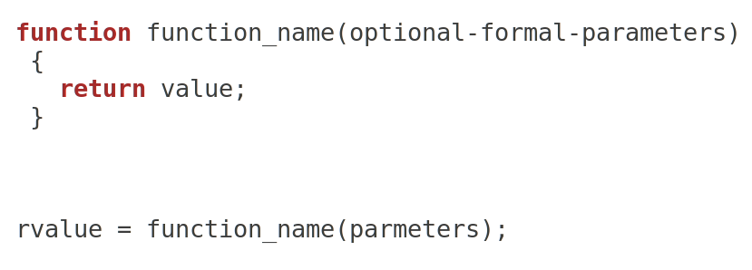
How to Put a JavaScript Into an HTML Page?
Function and Function call
Functions are objects in JavaScript
<html>
<body>
<script type="text/javascript">
document.write("Hello World!")
</script>
</body>
</html>
Department of Computer Science and Engineering, GIT

Slide 24
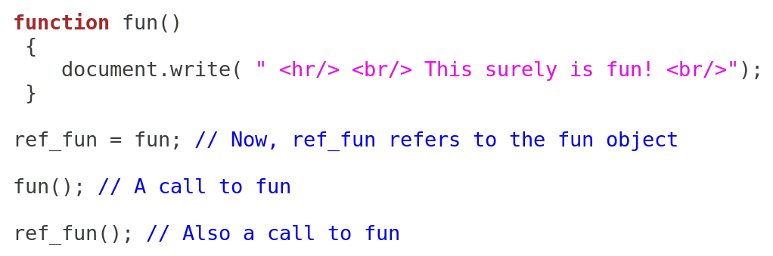
How to Put a JavaScript Into an HTML Page?
Function and Function call
Functions are objects in JavaScript
<html>
<body>
<script type="text/javascript">
document.write("Hello World!")
</script>
</body>
</html>
Department of Computer Science and Engineering, GIT

Slide 25
How to Put a JavaScript Into an HTML Page?
Regular Expressions
Regular expressions are used to specify patterns in strings
JavaScript provides two methods to use regular expressions in pattern matching
String methods
RegExp objects
A literal regular expression pattern is indicated by enclosing the pattern in slashes
The search method returns the position of a match, if found,
or
-1 if no match was found
stringVaraible.search()
<html>
<body>
<script type="text/javascript">
document.write("Hello World!")
</script>
</body>
</html>
Department of Computer Science and Engineering, GIT

Slide 26
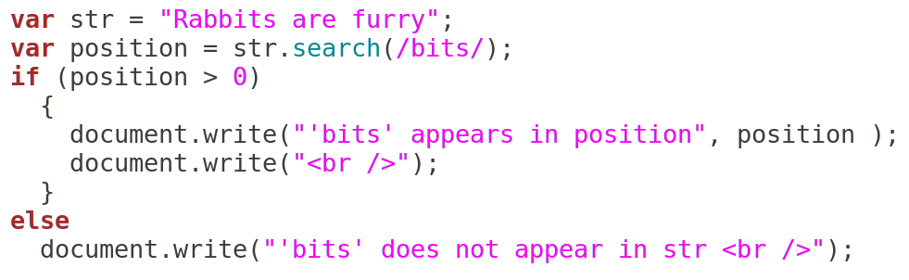
How to Put a JavaScript Into an HTML Page?
Regular Expressions
What would be the output?
<html>
<body>
<script type="text/javascript">
document.write("Hello World!")
</script>
</body>
</html>
Department of Computer Science and Engineering, GIT

Slide 27
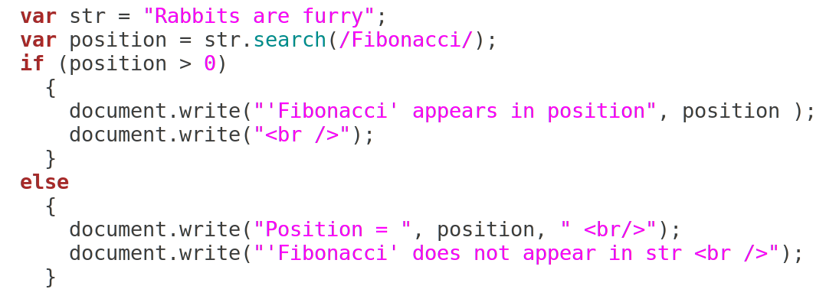
How to Put a JavaScript Into an HTML Page?
Regular Expressions
What would be the output?
<html>
<body>
<script type="text/javascript">
document.write("Hello World!")
</script>
</body>
</html>
Department of Computer Science and Engineering, GIT

Slide 28
How to Put a JavaScript Into an HTML Page?
Regular Expressions - Metacharacters
Metacharacters have special meaning in regular expressions
\ | ( ) [ ] { } ^ $ * + ? .
These characters may be used literally by escaping them with \
A period matches any single character
/f.r/ matches for and far and fir but not fr
<html>
<body>
<script type="text/javascript">
document.write("Hello World!")
</script>
</body>
</html>
Department of Computer Science and Engineering, GIT

Slide 29
How to Put a JavaScript Into an HTML Page?
Regular Expressions - Metacharacters
A character class matches one of a specified set of characters
[character set]
List characters individually: [abcdef]
Give a range of characters: [a-z]
Beware of [A-z]
^ at the beginning negates the class
<html>
<body>
<script type="text/javascript">
document.write("Hello World!")
</script>
</body>
</html>
Department of Computer Science and Engineering, GIT

Slide 30
How to Put a JavaScript Into an HTML Page?
Regular Expressions - Predefined character classes
<html>
<body>
<script type="text/javascript">
document.write("Hello World!")
</script>
</body>
</html>
Name | Equivalent Pattern | Matches
\d | [0-9] | A digit
\D | [^0-9] | Not a digit
\w | [A-Za-z_0-9] | A word character (alphanumeric)
\W | [^A-Za-z_0-9] | Not a word character
\s | [ \r\t\n\f] | A whitespace character
\S | [^ \r\t\n\f] | Not a whitespace character
Department of Computer Science and Engineering, GIT

Slide 31
How to Put a JavaScript Into an HTML Page?
Regular Expressions - Repeated Matches
A pattern can be repeated a fixed number of times by following it with a pair of curly braces enclosing a count
A pattern can be repeated by following it with one of the following special characters
* indicates zero or more repetitions of the previous pattern
+ indicates one or more of the previous pattern
? indicates zero or one of the previous pattern
/\(\d{3}\)\-\d{3}\-\d{4}/ might represent a telephone number (Thats for USA)
/[$_a-zA-Z][$_a-zA-Z0-9]*/ matches identifiers
<html>
<body>
<script type="text/javascript">
document.write("Hello World!")
</script>
</body>
</html>
Department of Computer Science and Engineering, GIT

Slide 32
How to Put a JavaScript Into an HTML Page?
Regular Expressions - Anchors
Anchors in regular expressions match positions rather than characters
Anchoring to the end of a string
^ at the beginning of a pattern matches the beginning of a string
$ at the end of a pattern matches the end of a string
<html>
<body>
<script type="text/javascript">
document.write("Hello World!")
</script>
</body>
</html>
Department of Computer Science and Engineering, GIT

Slide 33

How to Put a JavaScript Into an HTML Page?
value and match methods, length property
object.value - returns object's own enumerable property
match() -
method retrieves the matches when matching a string against a regular expression
Returns - An Array containing the entire match result and any parentheses-captured matched results;
null if there were no matches.
<html>
<body>
<script type="text/javascript">
document.write("Hello World!")
</script>
</body>
</html>
Department of Computer Science and Engineering, GIT

Slide 34

How to Put a JavaScript Into an HTML Page?
value and match methods, length property
length property represents the length of a string
For an empty string, length is 0.
<html>
<body>
<script type="text/javascript">
document.write("Hello World!")
</script>
</body>
</html>
Department of Computer Science and Engineering, GIT

Slide 35
How to Put a JavaScript Into an HTML Page?
HTML Form
A form is the usual way information is gathered from a browser
When the Submit button of a form is clicked, the form’s values are sent to the server
Components of a form are defined in the content of a <form> tag
Attributes – action , method
action, specifies the URL that is to be called when the Submit button is clicked
<html>
<body>
<script type="text/javascript">
document.write("Hello World!")
</script>
</body>
</html>
Department of Computer Science and Engineering, GIT

Slide 36
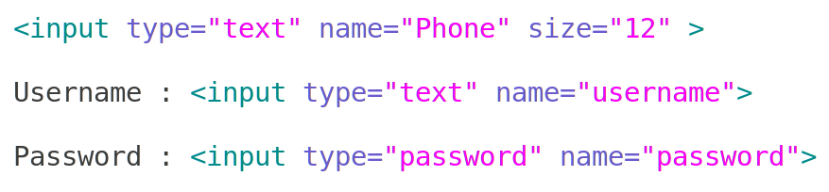
How to Put a JavaScript Into an HTML Page?
HTML Form
Attributes – action , method
method , specifies one of the two possible techniques of transferring the form data to the server, get and post
input tag
The type attribute of <input> specifies the kind of widget being created
text - Creates a horizontal box for text input
Check box , Radio button , Select menu
<html>
<body>
<script type="text/javascript">
document.write("Hello World!")
</script>
</body>
</html>
Department of Computer Science and Engineering, GIT

Slide 37
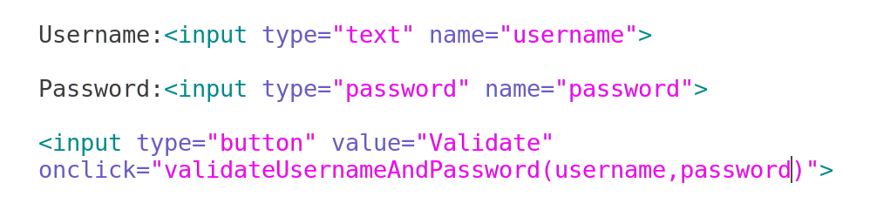
How to Put a JavaScript Into an HTML Page?
HTML Form
button - Creates a button
onClick attribute
<html>
<body>
<script type="text/javascript">
document.write("Hello World!")
</script>
</body>
</html>
Department of Computer Science and Engineering, GIT

Slide 38
How to Put a JavaScript Into an HTML Page?
Event
Users actions, such as mouse clicks and key presses, are referred to as events
HTML events are "things" that happen to HTML elements
When JavaScript is used in HTML pages, JavaScript can "react" on these events.
The main task of most JavaScript programs is to respond to events
<html>
<body>
<script type="text/javascript">
document.write("Hello World!")
</script>
</body>
</html>
Department of Computer Science and Engineering, GIT

Slide 39
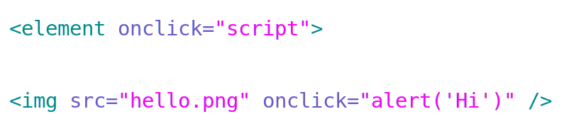
How to Put a JavaScript Into an HTML Page?
onclick event
button – type button creates a button with name as mentioned in attribute value
onClick attribute - event handler is called when the object is clicked
Example - Execute a JavaScript when a button is clicked
<html>
<body>
<script type="text/javascript">
document.write("Hello World!")
</script>
</body>
</html>
Department of Computer Science and Engineering, GIT

Slide 40
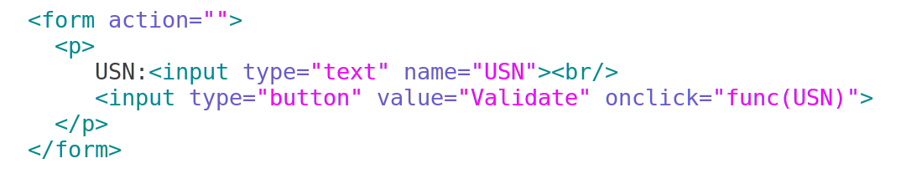
2a. Pseudo Code / Outline of the Algorithm
Department of Computer Science and Engineering, GIT

Slide 41
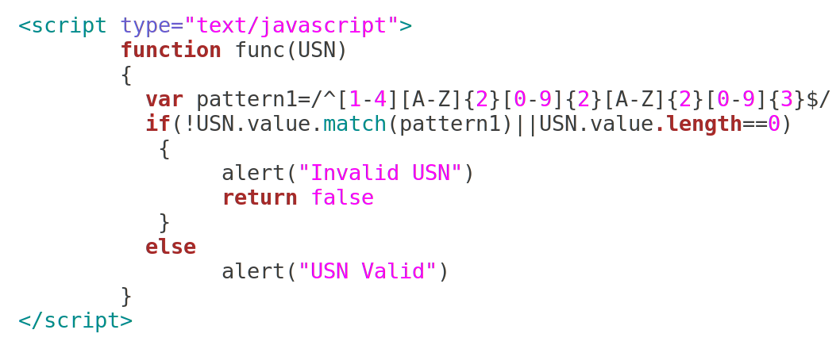
2a. Pseudo Code / Outline of the Algorithm
Department of Computer Science and Engineering, GIT

Slide 42
2a. Pseudo Code / Outline of the Algorithm
Each pattern uses the ^ and $ anchors to make sure the entire string matches
Department of Computer Science and Engineering, GIT

Slide 43
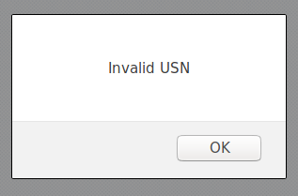

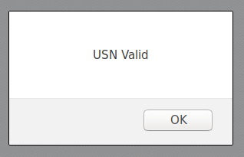

Sample Run
Department of Computer Science and Engineering, GIT

Slide 44
How to Put a JavaScript Into an HTML Page?
onclick event
button – type button creates a button with name as mentioned in attribute value
onClick attribute - event handler is called when the object is clicked
Execute a JavaScript which validates username and password when a button “Validate” is clicked
<html>
<body>
<script type="text/javascript">
document.write("Hello World!")
</script>
</body>
</html>
Department of Computer Science and Engineering, GIT

Slide 45
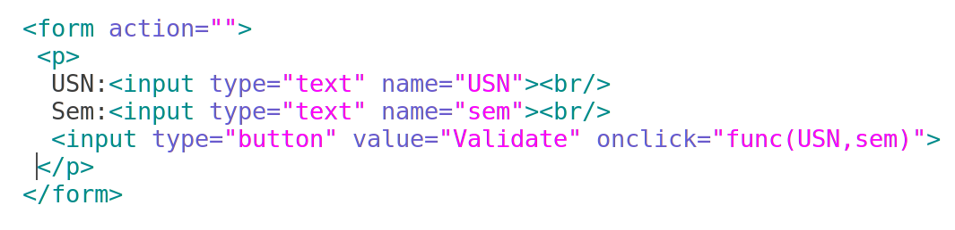
2b. Pseudo Code / Outline of the Algorithm
Department of Computer Science and Engineering, GIT

Slide 46
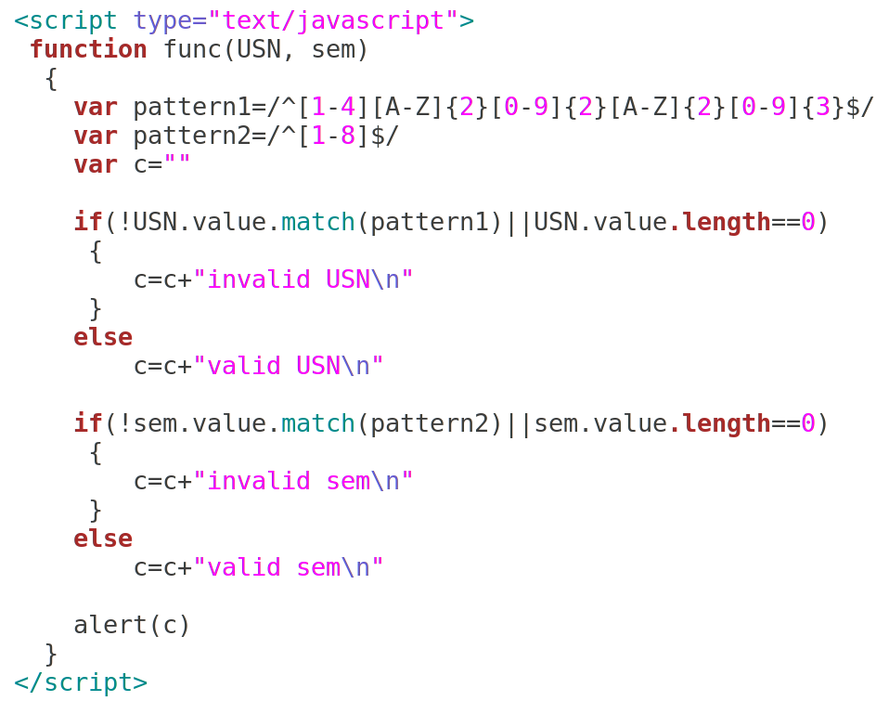
2b. Pseudo Code / Outline of the Algorithm
Department of Computer Science and Engineering, GIT

Slide 47
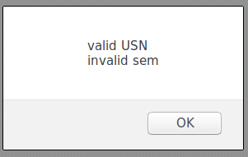
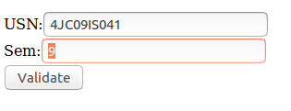
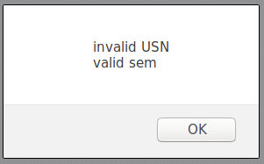
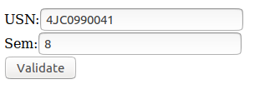
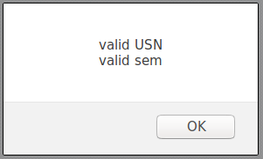
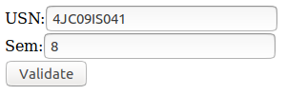
Sample Run
Department of Computer Science and Engineering, GIT

Slide 48
Learning Outcomes of the Experiment
At the end of the session, students should be able to :
1) Explain the features of Javascript. [L2]
2) Experiment with the usage of basic programming concepts like variables,
data types and conditional statements [L3]
Department of Computer Science and Engineering, GIT

Slide 49

How to Put a JavaScript Into an HTML Page?
Firebug
[ http://getfirebug.com/img/firebug-large.png ]
<html>
<body>
<script type="text/javascript">
document.write("Hello World!")
</script>
</body>
</html>
Department of Computer Science and Engineering, GIT

